Slide 1


IA-Images recognition
Jose Carlos pacheco Sánchez
A01702828

Slide 2
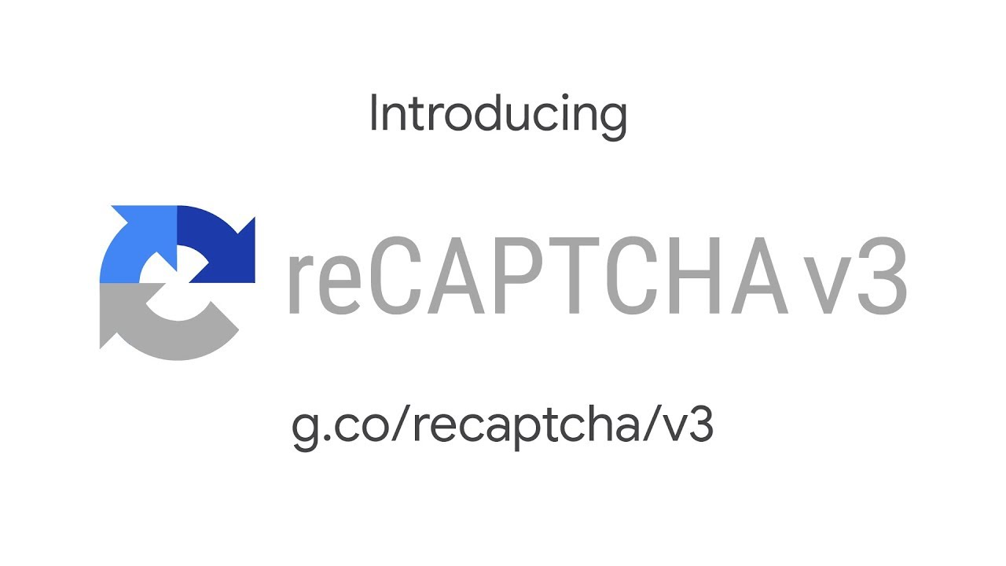
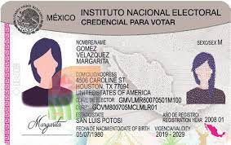

Project overview
Objetive: Make a neural network that allows reading numbers written by hand
Applications: Base for recognition of numbers on cards, IDs etc, break Google's Re-Captchar v 0.8
Notes:
This Project is one of the bases for number recognitions, for example on Ids, credit cards or even to breack the 0.8 versión of recapthca
The main pruporse of the Project is to manage and undesrtand a neural netwrok that can identfy a writen number

Slide 3



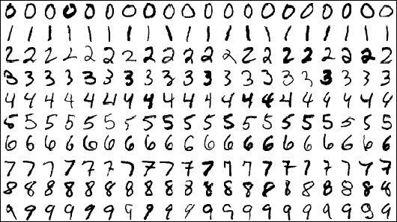
TOOLS
Python (Language)
Tensor Flow (Framework)
Keras (API)
MNIST (Dataset)
Notes:
We used some specific tolos,
As main langauge of course Python
We use TensorFlow as main framewrok but we use Keras for the layer and training model
And finally the MNIST dataset (big dataset of written images )

Slide 4

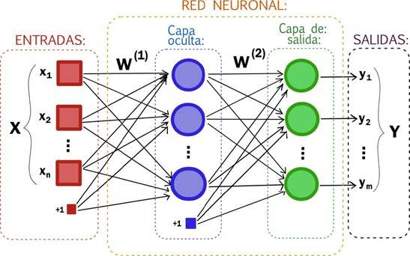

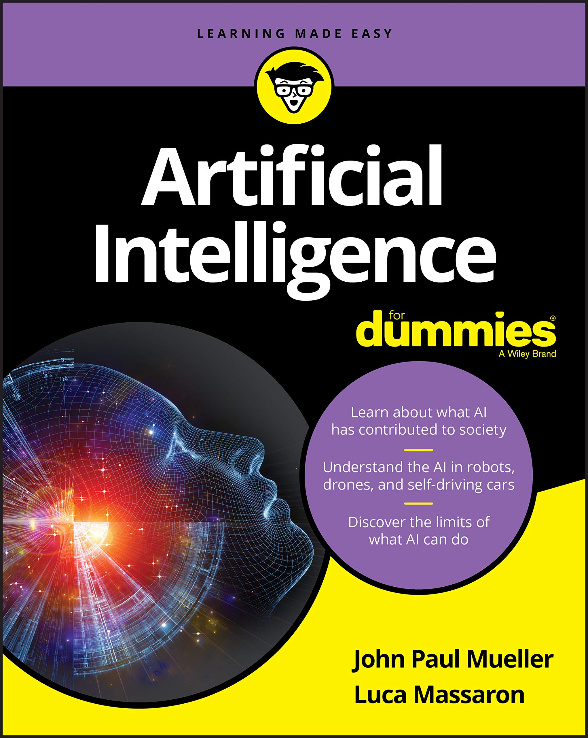
HOW?
v
v
v
v
28 x 28 pixels = 784 pixels
Notes:
The first step is knowing what we want
As input we are going to recibe a written number, then this input Will go throug the neural network and finally as oputpu we are going to manage a number
How? De dataset is providing us with 28 x 28 images giving us a total of 784 pixels, we are going to pass this image to black and White , breaking each row into each pixel and asigning 0 or 255 black and White each one

Slide 5
Input Layer
Hidden Layer
Hidden Layer
Output Layer
10 nuerons (for each number 0,1,2,3,4,5,6,7,8,9)
784 neurons (for each pixel)
N nuerons
N nuerons
Notes:
Now we need to initializate the input layer, as we said we have 784 pixels so we need 784 neurons for each pixel
In this case we use 2 hidden layers with n neurosn as intermediaries with the output, wich Will be a layer of 10 nerons (0,1,2,3,4,5,6,7,8,9) for each number

Slide 6
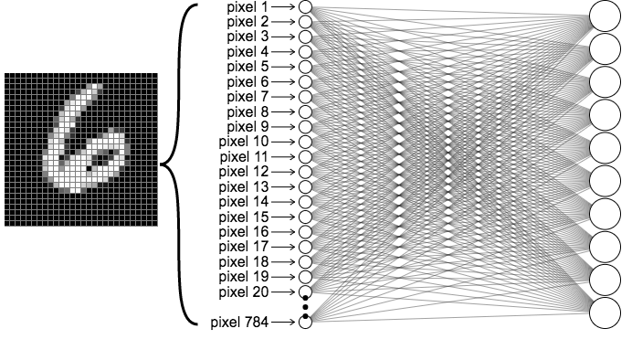
Notes:
It Will look more les like this but bigger

Slide 7
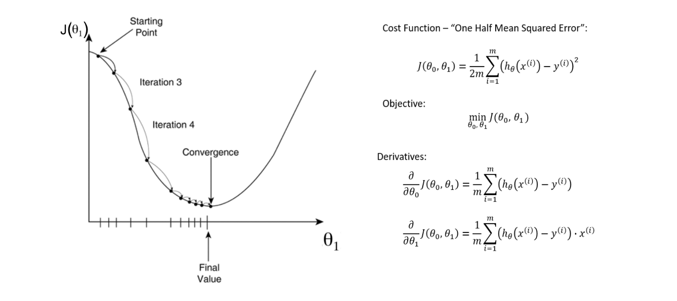
Training
COST FUNCTION + OPTIMIZATION + EPOCHS -> Less errors
Weights: Relationship between each neuron
Thresholds: How each neuron work
Optimizator: adamOR sgd
(see more on the report “Training” section)
Notes:
We need to train this model, so we are using the cost function + an optimizar + many epochs or loops,
On this case we are using Adam or sgd ( the gradient dscent cost function)
If yyou want to see more, look at the training secction on the report

Slide 8
TOPICS USED
Supervised Learning (Datset base)
Deep network (more than 1 hidden layer)
Batch learning (cost function + optimizator)
Dense Layers (each neuron conect with another)
Classification
Notes:
So, for this Project we are using many topics
Supervised learining as we already know wich number is wich
Deep network because we have more tan one hidden layer
Bathc learining, as we use the cost function + the optimizar
Dense layers as each nerón conects with at least one nerons on evrey layer
Classificaiont, as we manage to only know if its 0,1,2,3,4,5,6,7,8 or 9

